Slide 1
Introduction to Android
Dept. of B.Voc Software Development and System Administration
St. Joseph’s College(Autonomous)
Trichy-02
By
Dr. J. Ronald Martin

Slide 2
ANDROID
It is a open source software platform and operating system for mobile devices
Based on the Linux kernel
Developed by Google and later the Open Handset Alliance (OHA)
Allows writing managed code in the Java language
Android has its own virtual machine i.e. DVM(Dalvik Virtual Machine),which is used for executing the android application.
Google purchased the initial developer of the software , android incorporated in 2005.

Slide 3
ANDROID ARCHITECTURE
The software stack is split into Four Layers::
The application layer
The application framework
The libraries and runtime
The kernel
LINUX KERNEL
The architecture is based on the Linux2.6 kernel. This layer is core of android architecture.
It provides service like power management, memory management, security etc.
It helps in software or hardware binding for better communication.

Slide 4
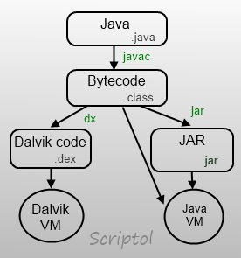
DALVIK VIRTUAL MACHINE
Dalvik is a virtual machine where every android application runs. Through Dalvik, device is able to run multiple virtual machines through better memory management as Dalvik VMs are register based and hence memory efficient.

Slide 5
Android Directory Structure
src - Java source files associated with your project. This includes the Activity "controller" files as well as your models and helpers.
res - Resource files associated with your project. All graphics, strings, layouts, and other resource files are stored in the resource file hierarchy under the res directory.
res/layout - XML layout files that describe the views and layouts for each activity and for partial views such as list items.
res/values - XML files which store various attribute values. These include strings.xml, dimens.xml, styles.xml, colors.xml, themes.xml, and so on.

Slide 6
res/drawable - Here we store the various density-independent graphic assets used in our application.
res/drawable-hdpi - Series of folders for density specific images to use for various resolutions.
res/mipmap - most commonly used for application icons.

Slide 7
The most frequently edited files are:
res/layout/activity_main.xml - This file describes the layout of the activity's UI. This means the placement of every view object on one app screen.
src/.../MainActivity.java - The Activity "controller" that constructs the activity using the view, and handles all event handling and view logic for one app screen.
AndroidManifest.xml - This is the Android application definition file. It contains information about the Android application such as minimum Android version, permission to access Android device capabilities such as internet access permission, ability to use phone permission, etc.

Slide 8
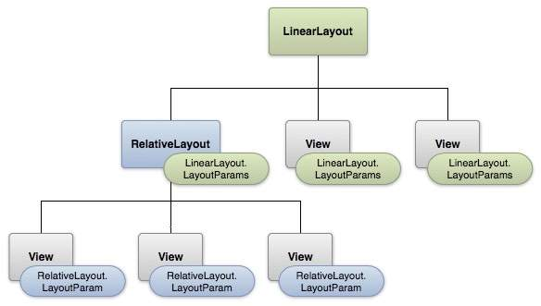
Android - UI Layouts

Slide 9
Android Layout Types
There are number of Layouts provided by Android which will use in almost all the Android applications to provide different view, look and feel.
Sr.No | Layout & Description
1 | Linear Layout LinearLayout is a view group that aligns all children in a single direction, vertically or horizontally.
2 | Relative Layout RelativeLayout is a view group that displays child views in relative positions.
3 | Table Layout TableLayout is a view that groups views into rows and columns.

Slide 10
4 | Absolute Layout AbsoluteLayout enables you to specify the exact location of its children.
5 | Frame Layout The FrameLayout is a placeholder on screen that you can use to display a single view.
6 | List View ListView is a view group that displays a list of scrollable items.
7 | Grid View GridView is a ViewGroup that displays items in a two-dimensional, scrollable grid.

Slide 11
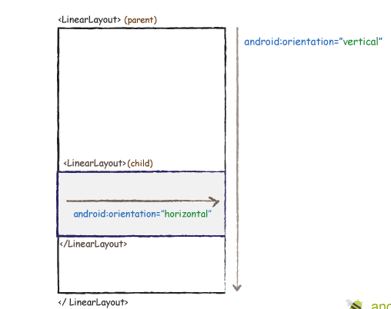
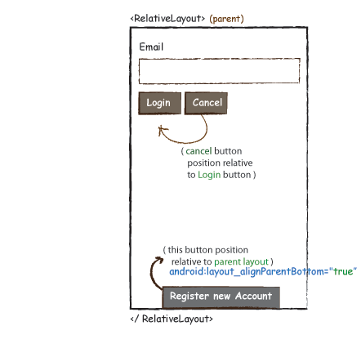

Slide 12
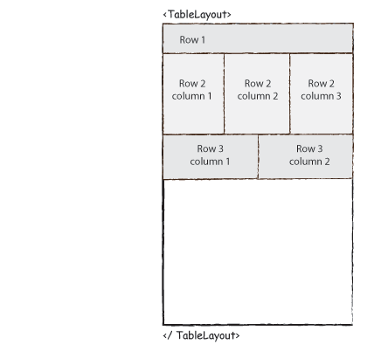

Slide 13
Android App software components
Activity
Service
Broadcast Receiver
Intent
Content Provider

Slide 14
Activity
Activities provide a user interface for one specific task, Basic component of most applications
Most applications have several activities that start each other as needed
Each is implemented as a subclass of the base Activity class

Slide 15
Service
Services execute background processing, no visual interface
Ex: Downloads, Playing Music, TCP/UDP Server
can bind to an existing service, control its operation, and run in background
Play music, alarm clock, etc.
Secured if using permissions
Callers may need to verify that service is the correct one

Slide 16
Content provider
Content providers are data storage facilities which supports data exchange between applications
Make data available to other applications
Transfer data between applications in Android
Other applications use a ContentResolver object to access the data provided via a ContentProvider

Slide 17
Broadcast receivers
Broadcast receivers act as mailboxes for messages from other applications. It receives and reacts to broadcast announcements
If an app registered the receiver in adv., the event will notify and call back the registered software
Ex: Low battery, power connected, shutdown, timezone changed, etc.

Slide 18
Intent
An Intent is a simple message object that is used to communicate between android components such as activities, content providers, broadcast receivers and services. Intents are also used to transfer data between activities.
Intent is a goal action component which takes care of the process of inter-components communication (ICC)
Intent is simply a message object containing a destination component address and data
Protection
Each application executes as its own user identity, such that OS provides system-level isolation;
Android middleware contains a reference monitor that mediates the inter-component communication (ICC).

Slide 19
Intent action:
Start an Activity
Broadcast events or changes
Start, stop, resume. or communicate with background Services
Access data held by ContentProviders
Call back to handle events
Carry data with Extras (key, value)

Slide 20
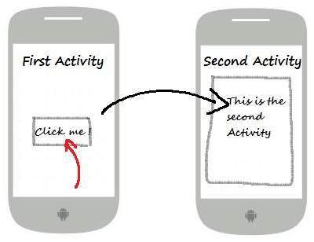
Intents are used generally for starting a new activity using startActivity().
Use of Intent
For Launching an Activity
To start a New Service
For Broadcasting Messages
To Display a list of contacts in ListView
Intent is of two types:
Implicit Intent
Explicit Intent

